Slide 1
Creating and Adding Custom IP
Zynq
Vivado 2014.2 Version

Slide 2
Objectives
After completing this module, you will be able to:
Describe the AXI4 transactions
Summarize the AXI4 valid/ready acknowledgment model
Discuss the AXI4 transactional modes of overlap and simultaneous operations
Describe the operation of the AXI4 streaming protocol
List the steps involved in creating and packaging IP

Slide 3
Outline
AXI4 Transactions
AXI4-Lite Slave
AXI4-Lite Master
AXI4 Slave/Master
Create and Package IP
Custom IP
Summary

Slide 4
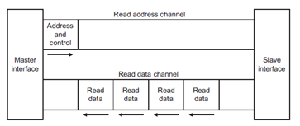
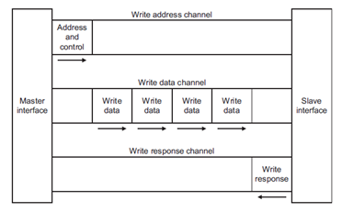
Basic AXI Transaction Channels
Read address channel
Read data channel
Write address channel
Write data channel
Write response channel
Non-posted write model
There will always be a "write response"

Slide 5
All AXI Channels Use A Basic “VALID/READY” Handshake
SOURCE asserts and holds VALID when DATA is available
DESTINATION asserts READY if able to accept DATA
DATA transferred when VALID and READY = 1
SOURCE sends next DATA (if an actual data channel) or deasserts VALID
DESTINATION deasserts READY if no longer able to accept DATA

Slide 6
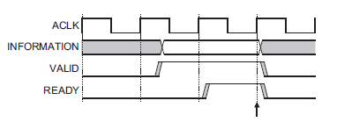
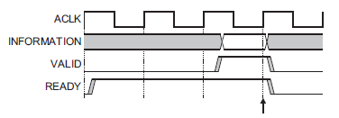
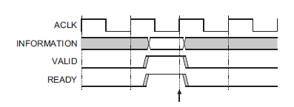
AXI Interface: Handshaking
AXI uses a valid/ready handshake acknowledge
Each channel has its own valid/ready
Address (read/write)
Data (read/write)
Response (write only)
Flexible signaling functionality
Inserting wait states
Always ready
Same cycle acknowledge
Inserting Wait States
Always Ready
Same Cycle Acknowledge
Notes:
It is up to the master to assert the valid signal and the slave to assert the ready signals for all channels except the read data channel where the slave asserts valid to indicate that it is returning data.
The agent that asserts ready determines the flexibility as seen in the three waveform options.

Slide 7
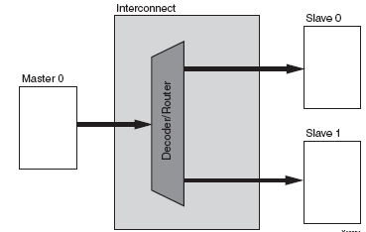
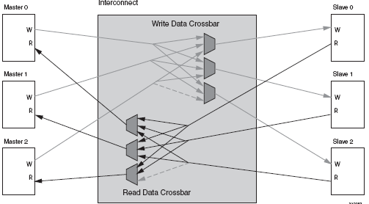
AXI Interconnect
axi_interconnect component
Highly configurable
Pass Through
Conversion Only
N-to-1 Interconnect
1-to-N Interconnect
N-to-M Interconnect – full crossbar
N-to-M Interconnect – shared bus structure
Decoupled master and slave interfaces
Notes:
The AXI interconnect is added as any other component to the hardware in IP Integrator’s Block Diagram and then connected to the target processor and various IP bus cores provided by Xilinx.
The processor is always a master on the bus.
The actual implementation of the AXI interconnect is with slice combinatorial logic to implement the ORed structure of the decoupled address, data, and controls signals.
The context of “decoupled” refers to the fact that all the signals are unidirectional as inputs and outputs; that is, data in and data out, as opposed to a 3-state structure. The concept of a master is the bus agent that starts the transaction and owns the address out and control out signals.
The Xilinx implementation of the AXI interface is documented in the Xilinx AXI Reference Guide (UG761).
http://www.xilinx.com/support/documentation/ip_documentation/axi_interconnect/v1_05_a/ds768_axi_interconnect.pdf

Slide 8
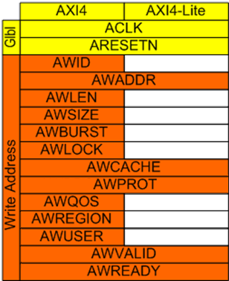
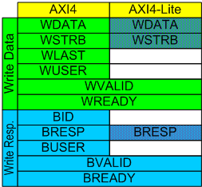
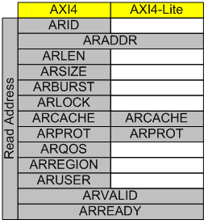
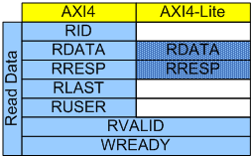
AXI4 Signals (AXI4, AXI4-Lite)

Slide 9
AXI4 signals
ID – Identification signal
LEN – Burst length; 256 INCR, 16 Wrap
Size – Transfer width 8-256 bytes
Burst – INCR, WRAP, FIXED
Lock – Exclusive, atomic access
CACHE –Transaction caching
PROT – Access Protection
QOS – QOS signal
Region – allows multiple logical interfaces on slave
User – User signal
STRB – strobe
LAST – Indicate last transaction in burst
See AMBA® AXI™ and ACE™ Protocol Specification
Notes:
ID – transaction ordering. Read transactions on the same master with same ID must complete in order they were presented. Same for write, but no requirement to preserve order of read and writes together. Facilitates overlapped transactions
Not usually implemented in Xilinx IP:
LOCK – Support atomic accesses; Normal, exclusive (semaphore without requiring LOCK), lock
CACHE signal can be used to determine which component provides the write response. If a write transaction is indicated as bufferable then it is acceptable for a bridge or system level cache to provide the write response. If, however, the transaction is indicated as being non-bufferable then the write response must be provided from the final destination of the transaction.
PROT Protection against illegal transactions. PROT gives three levels of access protection:
Normal or privileged
This is used by some masters to indicate their processing mode. A privileged processing mode typically has a greater level of access within a system.
Secure or non-secure
This is used in systems where a greater degree of differentiation between processing modes is required.
Instruction or data
This bit gives an indication if the transaction is an instruction or a data access.
REGION identifiers means a single physical interface on a slave can provide multiple logical interfaces, each with a different location in the system address map. The use of the region identifier means that the slave does not have to support the address decode between the different logical interfaces.
USER defined signal. Must be supported by all interacting peripherals in the system

Slide 10
Outline
AXI4 Transactions
AXI4-Lite Slave
AXI4-Lite Master
AXI4 Slave/Master
Create and Package IP
Custom IP
Summary

Slide 11
AXI4-Lite Slave
AXI4-Lite is a subset of AXI (Full)
Same channels, but less signals than full interface
5 AXI channels
Inputs: Write Address, Data; Read Address
Outputs: Write Response; Read Data
Slave responds to read and write transactions from upstream Master
1 data transfer per transaction
No burst support
Intended for lower performance peripherals
led_ip_v1_0_S_AXI.v
AXI Interconnect
AXI4-Lite IP (Slave)
led_ip_v1_0.v
Write Addr
AXI Transaction logic
(Ready, Valid, Response)
User IP
Write Data
Write Response
Read Addr
Registers
Read Data
lab3_user_logic.v

Slide 12
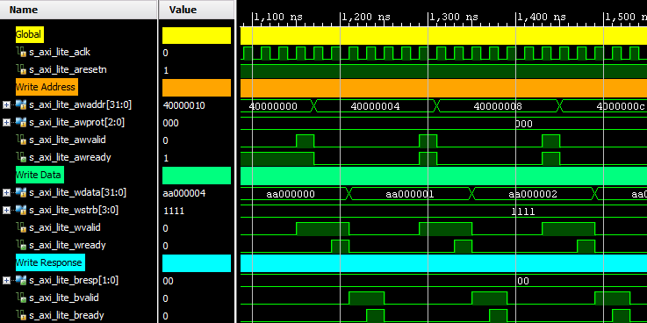
AXI Lite Slave Single Data Phase Write
input
output
Notes:
The write and read transactions are initiated by the upstream or Master device. The slave responds to the transaction request

Slide 13
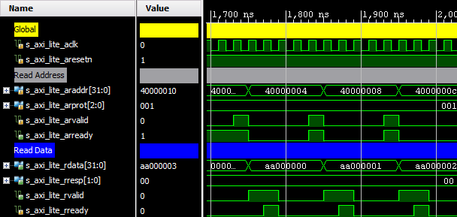
AXI Lite Slave Single Data Phase Read
input
output

Slide 14
Outline
AXI4 Transactions
AXI4-Lite Slave
AXI4-Lite Master
AXI4 Slave/Master
Create and Package IP
Custom IP
Summary

Slide 15
AXI4-Lite Master
<ip_name>_v<1_0>_S_AXI.v
5 AXI channels
Outputs: Write Address, Data; Read Address
Inputs: Write Response; Read Data
Opposite directions to Slave
Master can initiate read and write transactions
1 data transfer per transaction
No burst support
Addressable register bank in slave
AXI Interconnect
AXI4-Lite IP (Master)
<ip_name>_v<1_0>.v
Write Addr
AXI Transaction logic
(Generate transactions, Ready, Valid)
User IP
Write Data
Write Response
Read Addr
Read Data
<filename>.v

Slide 16
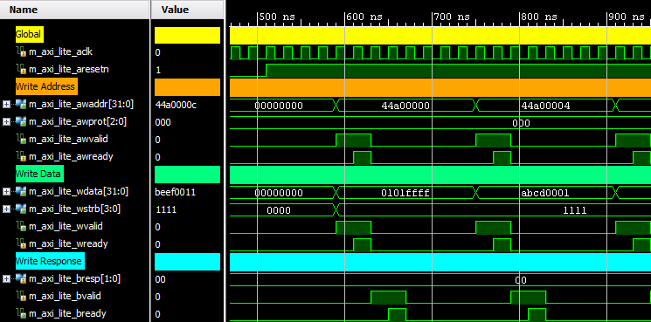
AXI4-Lite Master Single Data Phase Write
input
output
Notes:
Read and write transactions are initiated by the Master. Signals are similar to AXI4-Lite Slave, but channels are in the opposite direction.

Slide 17
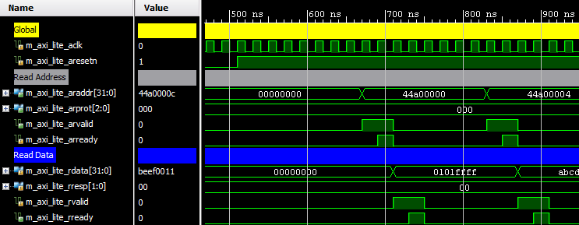
AXI4-Lite Master Single Data Phase Read
input
output

Slide 18
Outline
AXI4 Transactions
AXI4-Lite Slave
AXI4-Lite Master
AXI4 Slave/Master
Create and Package IP
Custom IP
Summary

Slide 19
AXI4
my_slave_ip_v1_0_M_AXI.v
Superset of AXI4-Lite
Extra signals to support additional features
Burst transactions
Transaction ordering
Not all AXI4 signals used by Xilinx IP
Ignored, or Pass through
Single Read/Write transactions similar to AXI lite
Transaction ID
LAST signal
Memory space
AXI4 IP (Slave)
my_slave_ip_v1_0.v
AXI Transaction logic
(Ready, Valid, Response)
User IP
Address space
user_logic.v

Slide 20
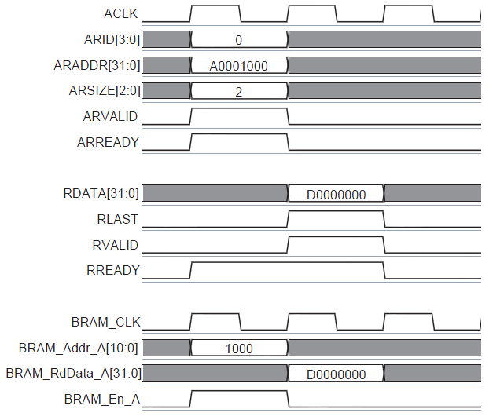
AXI4
Superset of AXI4-Lite
Extra signals to support additional features
Burst transactions
Transaction ordering
Not all AXI4 signals used by Xilinx IP
Ignored, or Pass through
Single Read/Write transactions similar to AXI lite
Transaction ID
LAST signal
Example of read from AXI4 BRAM

Slide 21
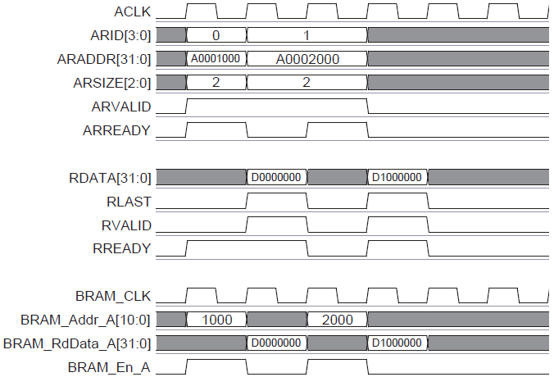
AXI4 Read Transaction Multiple reads, not burst transaction
Multiple read transactions are identified by different read IDs
For a burst transaction only one read ID would have been used
Separate RLAST for corresponding read transactions
ARSIZE=2 indicates 4 bytes are being read
0 : 1 byte
1 : 2 bytes
2 : 4 bytes
Example of multiple reads from AXI4 BRAM

Slide 22
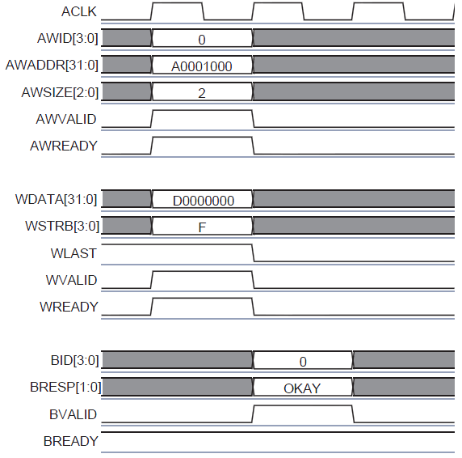
AXI4 Write Transaction
Example of AXI4 write transaction

Slide 23
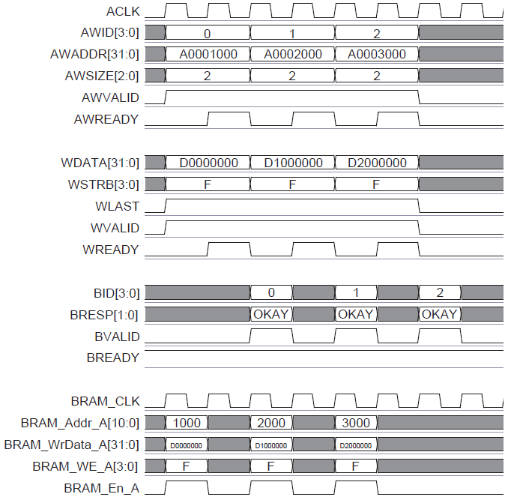
AXI4 Write Transaction Multiple write, not burst
Multiple write transactions are identified by different write IDs (AWID)
For a burst transaction only one write ID would have been used
Separate OKAY status for corresponding write transactions
WSTRB=0xF indicates entire word is being written
Example of AXI4 multiple write transactions

Slide 24
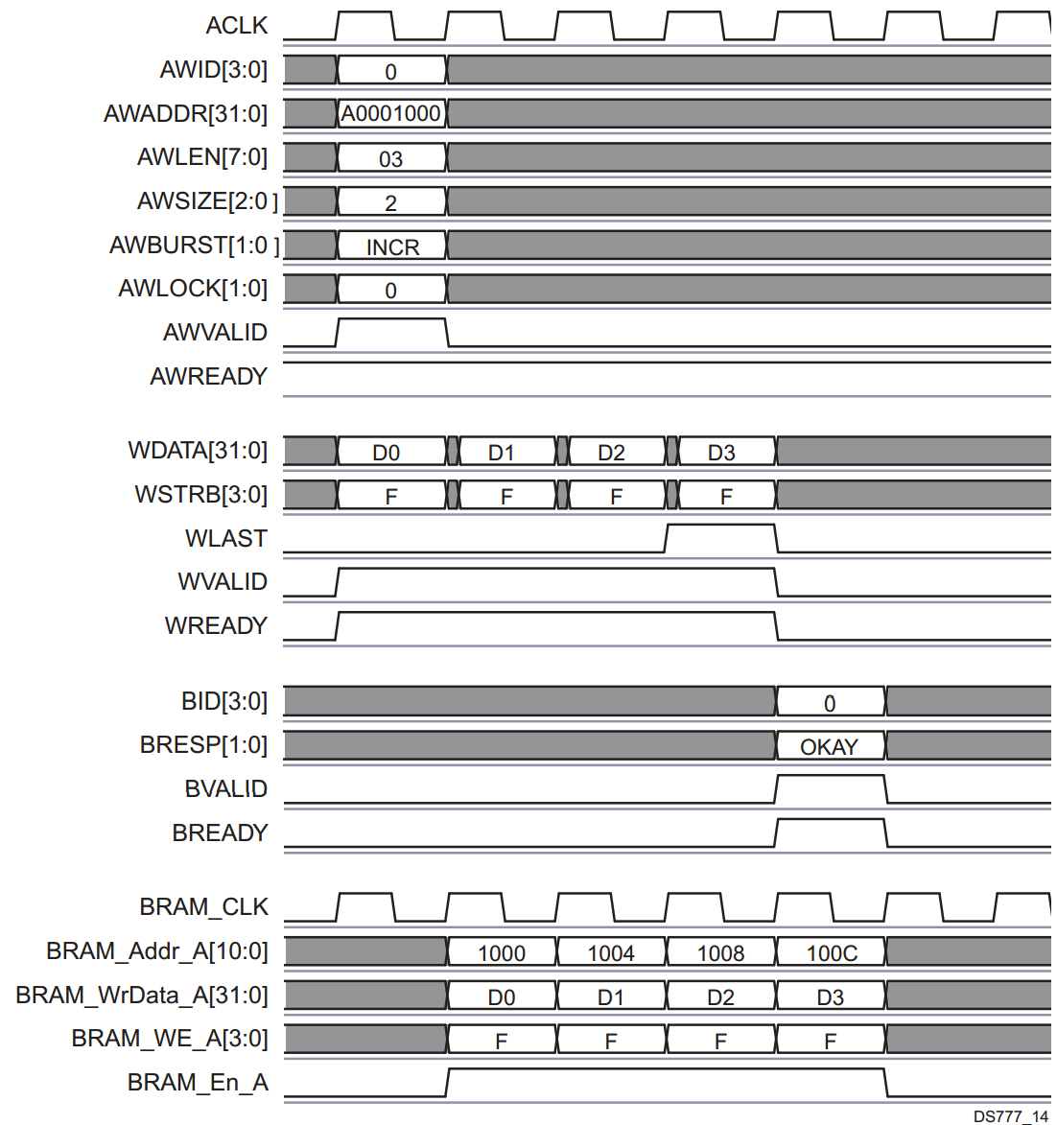

AXI4 Write Burst Burst Data Phase 4 Writes
Single Burst transaction
AWLEN = 3 (Burst Size)
Length = AWLEN+1 (4 transactions)
INCR from Base AWADDR
WSTRB=0xF indicates entire word is being written
LAST indicates end of burst
AWLEN also indicates the size of the burst
A burst must not cross a 4KB Boundary
Example of AXI4 write burst transaction
Notes:
The AXI burst Slave Attachment block supports fixed bursts of bytes, half-words, words, double-words, and quad words with transfer lengths of:
1 to 256 data beats with INC type transfers
1 to 16 data beats with FIXED type transfers
2, 4, 8, 16 data beats with WRAP type transfers
The figure above shows a burst request from a 32-bit master to the 32-bit slave.

Slide 25
Documentation
Xilinx AXI Reference Guide, UG761
AXI Usage in Xilinx FPGAs
Introduce key concepts of the AXI protocol
Explains what features of AXI Xilinx has adopted
ARM specifications
AMBA AXI Protocol Version 2.0
AMBA 4 AXI4-Stream Protocol Version 1.0
http://infocenter.arm.com/help/topic/com.arm.doc.set.amba

Slide 26
Outline
AXI4 Transactions
AXI4-Lite Slave
AXI4-Lite Master
AXI4 Slave/Master
Create and Package IP
Package IP
Create IP
Summary

Slide 27
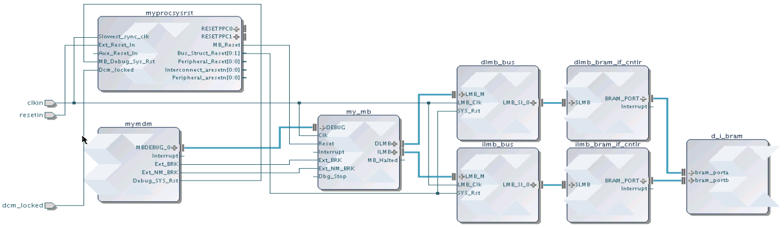
Reusing Your IP
IP from many sources can be packaged and made available in Vivado
All IP available in the Vivado IP Catalog can be used to create IP Integrator designs
Any IP Integrator diagram can be quickly packaged as a single complex IP
Standardized IP-XACT representation
Vivado IP Integrator
IP Catalog
Source (C, RTL, IP, etc)
Simulation Models
IP Packager
Xilinx IP
Documentation
Example Designs
3rd Party IP
Test Bench
User IP
Notes:
Vivado supports reuse of IP is by providing users a means to capture their individual IP or IP subsystems and package that IP, and then make the IP available to other users through the Vivado IP catalog. This approach also benefits third party IP providers, who now have a standard way of providing their IP for both evaluation and purchase, and that IP will be visible through the IP Catalog.
Packaging an IP Integrator diagram takes one Tcl command, or several mouse clicks.

Slide 28
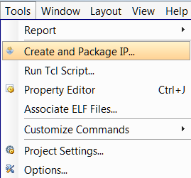
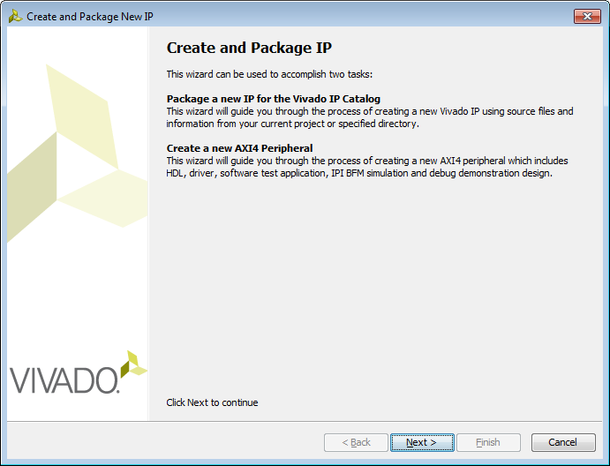
Create and Package IP
The Create and Package IP wizard allows you to
Create a template for a new peripheral
Package the current project
Only available if project is open
Package an existing project
The packager allows IP to be included in the IP Catalog for distribution
It uses IP-XACT format
Complete set of files included
Source code, Constraints, Test Benches (simulation files), documentation

Slide 29
Outline
AXI4 Transactions
AXI4-Lite Slave
AXI4-Lite Master
AXI4 Slave/Master
Create and Package IP
Create IP
Package IP
Summary

Slide 30
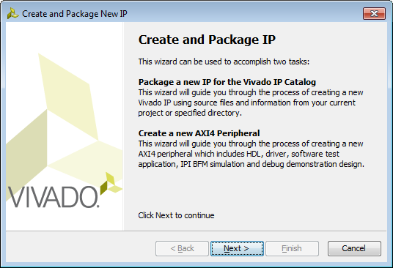
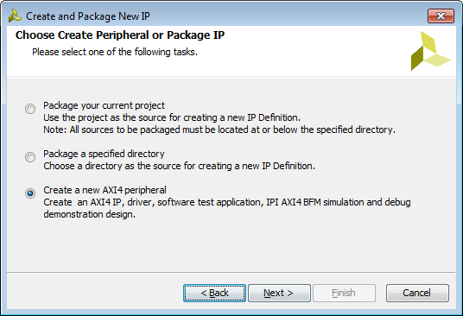
Create Custom IP
Create and Package IP Wizard
Generates HDL template for
Slave/Master
AXI Lite/Full/Stream
Optionally Generates
Software Driver
Only for AXI Lite and Full slave interface
Test Software Application
AXI4 BFM Example

Slide 31
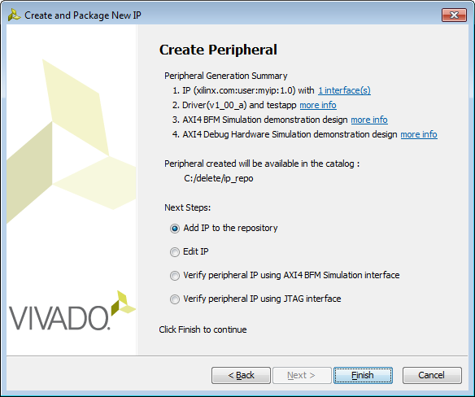
Create Custom IP
Add IP to repository
Edit IP
Verify
BFM Simulation Example Design
JTAG

Slide 32
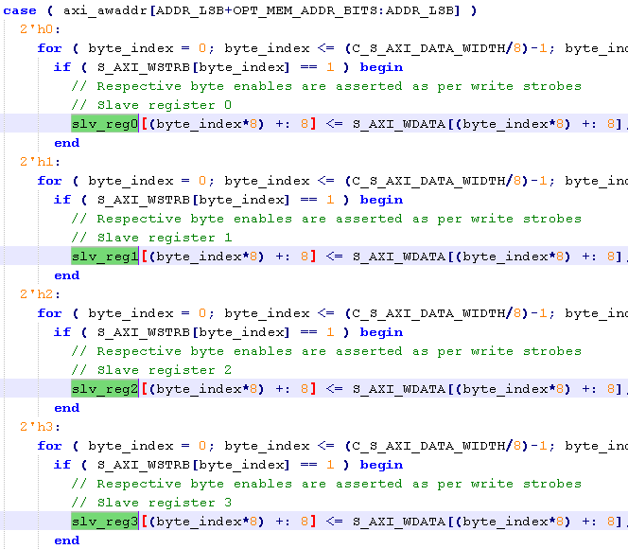
Generated Template for AXI Lite
HDL implementation of AXI Interface
32 bit data width
User specifies required number of registers (minimum 4)
Read/write to/from Registers implemented
User logic can be easily connected
User logic can be a hierarchical design

Slide 33
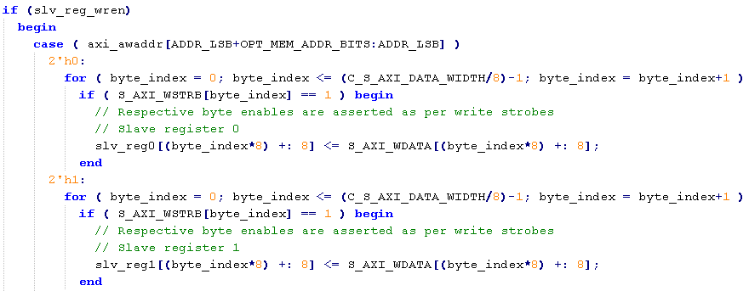
HDL AXI Lite
Connect user logic to registers, or modify design
Address
Register
Data

Slide 34
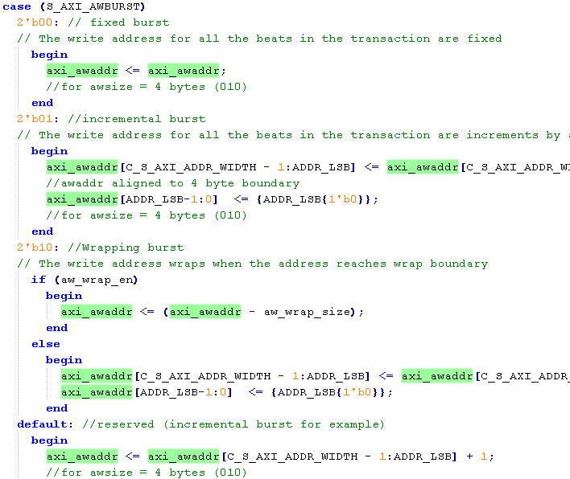
Generated Template for AXI Full
HDL AXI Full Interface
32 bit data interface
Burst transaction support implemented
Specify size of memory space
Up to 1024 Bytes
Example code implementing block memory
User logic can connect or replace this section

Slide 35
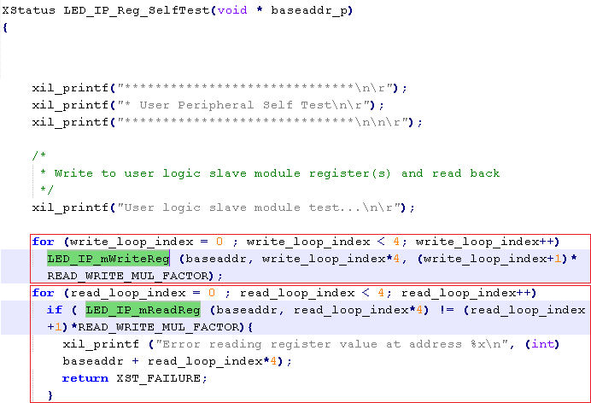
Files created
component.xml
IP XACT description
bd
Block Diagram tcl file
drivers
SDK and software files (c code)
Simple register/memory read/write functionality
Simple SelfTest() code
hdl
Verilog/VHDL (should be inside project directory
xgui
GUI tcl file

Slide 36
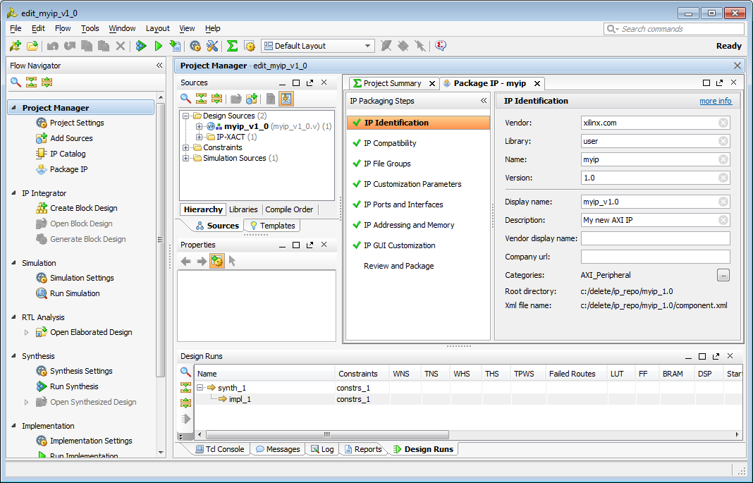
Edit IP
New Vivado project will open
Template files have been generated and are added to the project
IP can now be edited
Modify existing template files, add user source files
IP Packager will be open
Last step is to Package IP

Slide 37
Outline
AXI4 Transactions
AXI4-Lite Slave
AXI4-Lite Master
AXI4 Slave/Master
Create and Package IP
Create IP
Package IP
Summary

Slide 38
Package IP
Package current project
Must be open!
Package generated HDL
Package a directory (another project/source files)
Option to package as a library core
Core can be referenced by other IP
Core not available standalone (Will not display in IP Catalog)
Create New AXI4 Peripheral (previous section)
Will also need to be packaged
Similar steps to package for all three flows

Slide 39

IP-XACT
Industry Standard (IEEE) XML format to describe IP using meta-data
Ports
Interfaces
Configurable Parameters
Files, documentation
IP-XACT only describes high level information about IP, not low level description, so does not replace HDL or Software.
Enables automatic connection, configuration and integration
Enables integration of 3rd Party IP
(And Export of your own IP)

Slide 40
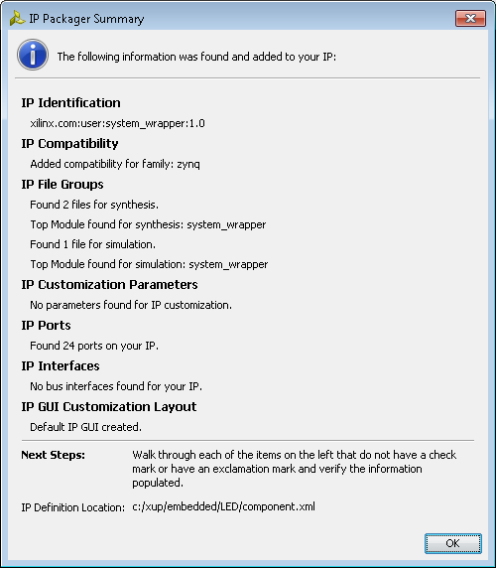
IP Packager
Automatically analyze project/files to determine parameters
Initial Summary
Identifies
Files
Source HDL, Testbenches, Documentation,
Parameters
Configurable
Ports
Interfaces
Compatibility
Creates GUI Layout for IPI

Slide 41
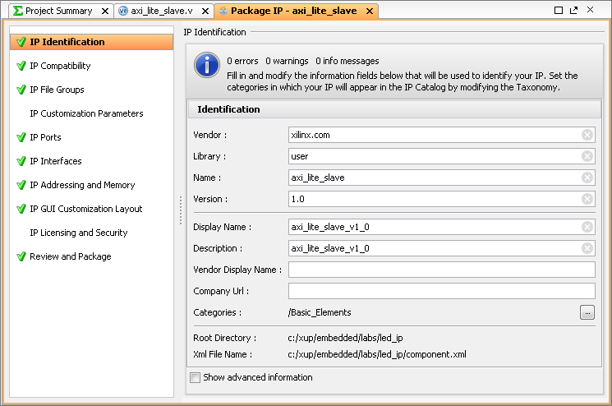
IP Packager
Modify configuration
Properties
Compatibility
Files
Custom parameters
Ports
Interfaces
Address and Memory
IP and security
Project can be updated – e.g. source files added
Changes will be reflected in packager
Review and package

Slide 42
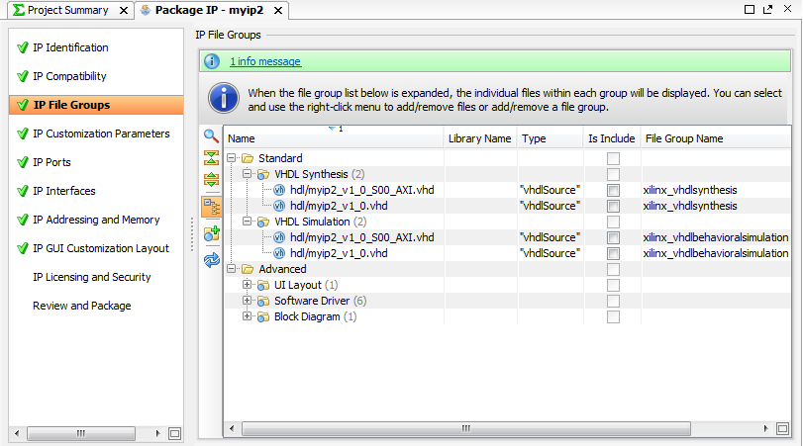
Customizing IP for Reuse in IP Packager
Select
Options
Add, Edit or change defaults
Notes:
The packager handles all the IP-XACT specific file creation, manages IP versions, recognizes interfaces, and creates customized configuration dialogs, as well as more advanced functionality.

Slide 43
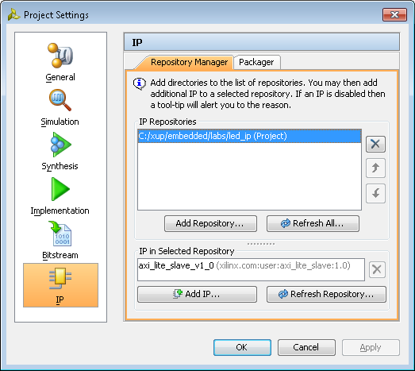
IP repository
The Vivado IP Catalog can be extended by adding additional IP Repositories.
Third party IP, your custom IP, and Xilinx IP are displayed in an identical manner
Packager creates .xml file for the IP
Specify the directory of the user/third party IP repository
Can be done automatically from packager
Access from project settings, or IP Catalog
Displays the IP that has been found
Displays IP in the repository for use in IPI

Slide 44
Creating and Using custom IP summary
Create and modify Template (add user logic) or create IP manually
Package IP
Specify configuration settings
Specify IP directory in the Vivado repository
Project settings
Available to use in IP Catalog like any other IP

Slide 45
Outline
AXI4 Transactions
AXI4-Lite Slave
AXI4-Lite Master
AXI4 Slave/Master
Create and Package IP
Custom IP
Summary

Slide 46
Summary
AXI4 interface defines five channels
All channels use basic VALID/READY handshake to complete a transfer
AXI Interconnect extends AXI interface by allowing 1-to-N, N-to-1, N-to-M, and M-to-N connections
Custom IP can be imported using IP Packager
Include in the IP Repository for reuse across projects
Create and Package wizard supports AXI Lite, Full, and Stream compatible IP creation and packaging
Handles interface side protocol
Provides template to add HDL functionality
Packages into the IP Catalog

